Slide 1
Matlab Simulink & MiP
Kurt Talke
12/3/2018

Slide 2
Outline
Matlab Simulink
MiP Demo
Getting started
Matlab toolboxes
BBB setup
Simulink setup

Slide 3
Simulink
Graphical model-based developmental tool
https://www.mathworks.com/videos/simulink-overview-61216.html
Tutorial links/videos
https://www.mathworks.com/videos/getting-started-with-simulink-69027.html
https://www.mathworks.com/videos/getting-started-with-simulink-part-1-building-and-simulating-a-simple-simulink-model-1508442030520.html
What is happening under the hood:
Mathworks support package interfaces with BBBlue.
Low level c-code wrapped into S-Blocks to touch hardware on BBB
Ex: rc_motor_set, rc_mpu_read_accel, rc_mpu_read_gyro, rc_encoder_read, etc…
Interesting logic and controls done in Simulink

Slide 4
MiP Demo
Demo Time
Balance Simulink model split into two parts:
Logic – for smooth start/stop behavior
Discrete time controller implementation
Discrete time controller
Plant

Slide 5
Plant
Support package has S-Blocks to touch BBBlue hardware

Slide 6
Discrete time controller implementation
Controller
Saturation
Plant

Slide 7
Controller
2 separate filters with DT controllers

Slide 8
Simulink
Need to install the following Matlab Toolboxes:
Simulink
Simulink coder
Embedded coder
Simulink embedded coder
Beagle bone blue support package

Slide 9
Getting Started: BBBlue
Install Debian 9.5 from 10/7/2018 (4.14.71)
https://debian.beagleboard.org/images/
Use “bone-debian-9.5-iot-armhf-2018-10-07-4gb.img.xz” to create a bootable SD card.
Flash using etcher
ssh into BBBBlue after boot using wifi hotspot:
$ ssh debian@192.168.7.2 (terminal for mac/linux, putty for Windows)
debian@192.168.7.2's password: “temppwd”
Check:
debian@beaglebone:~$ rc_version
1.0.3
debian@beaglebone:~$ uname -a
Linux beaglebone 4.14.71-ti-r80 #1 SMP PREEMPT Fri Oct 5 23:50:11 UTC 2018 armv7l GNU/Linux

Slide 10
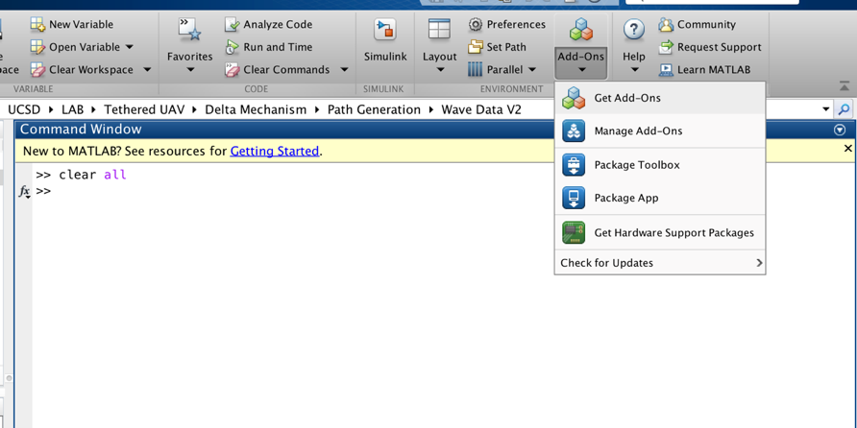
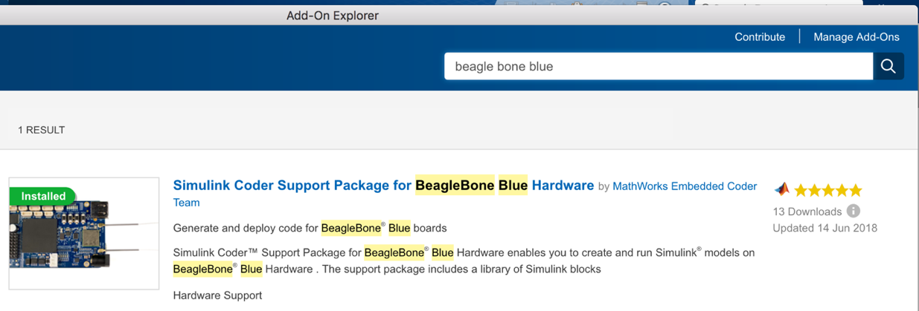
Getting Started: Matlab
Get BBB-Blue support package
New version to be released this week
Support for RC version 1.0.3
FCCR IMU Driver
https://github.com/ktalke12/Matlab_MiP
Read the “ReadMe”

Slide 11
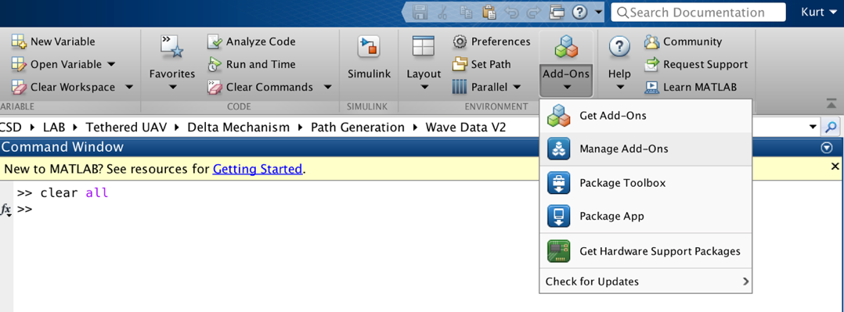
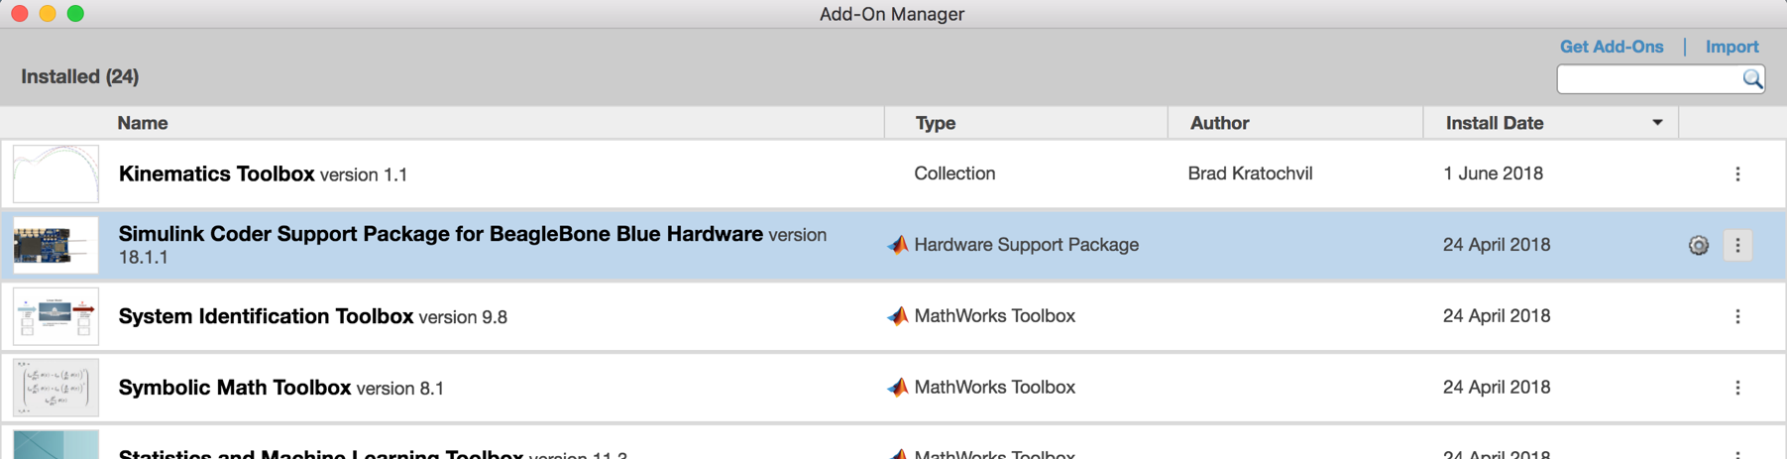
Matlab Setup
Manage Add-Ons
Setup BBBlue
Click on Setup

Slide 12
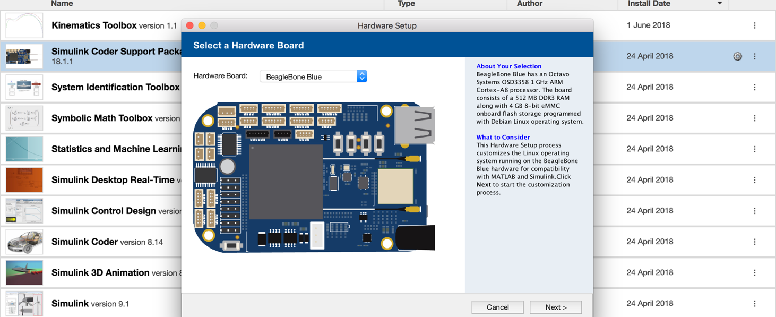
Matlab Setup
Follow setup instructions
Can setup wifi on UCSD Protected network:
PEAP, MSCHAPv2, username & password

Slide 13
Getting Started: Simulink
Configuration Parameters:
Set proper IP address in Balance.slx file
Set mode to “External”

Slide 14
Conclusion
Very easy to get started using BBBlue support package
Balance in Simulink already designed
Can use test your controllers
More exciting development possible
Steering control
IMU interrupt implementation

